Slide 1
THE OPEN DOOR
September 2022
I want to Thank you my Church Family, without your guidance, help and attendance we would no longer be. Through your faith we will continue to be a Church. I keep telling everyone that I have an awesome Church Family, and I do. THANK YOU FROM THE BOTTOM OF MY HEART.
We have had a successful Rummage Sale and now it is time for pies. We will be successful in that endeavor with your help. We also have Bible School for our youth so talk to Melissa ,she needs your help to continue our program and we want to reach our youth . They are our church's future. 200 years is coming up, let's make more history to add to our next 200 years.
Thank you Church Family.
Lisa
"The living, the living, he thanks you, as I do this day; the father makes known to the children your faithfulness."
Isaiah 38:19

Slide 2
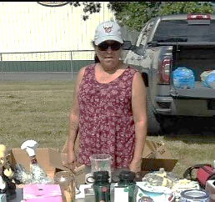
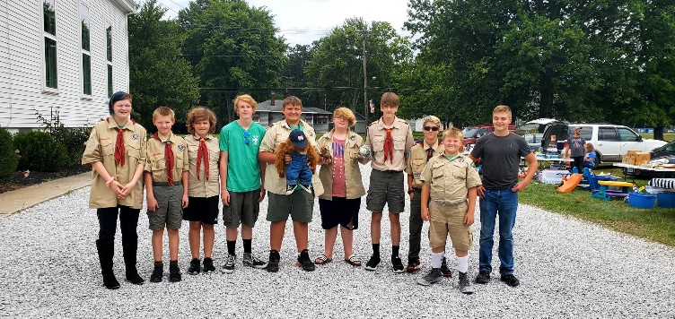
Thank you for the wonderful brunch for my final Sunday. It provided a great opportunity to fellowship and say goodbyes a bit slower. Thank you as well for the fun and thoughtful book of jokes. How clever! I appreciate the church framed picture too. Edinburg has been very special to us and we thank you for allowing us to be a part of your lives. Our new address is 410 W South Range Rd North Lima Ohio 44452 (email and phone number will remain the same).
Blessings to you,
Tim, Kim, Vera and Alena
I’d like to say thank you to Lisa Morehead for all she has done during this time (and all she still has to do).
Thank you to Caleb Oblisk, who sold hugs for $1.00 and donated 50% to the Church.
Thank you to the scouts that came out and helped with the church yard sale. (not all the came are pictured)
Lisa will send out a prayer request on Wednesday, send request to marialisamorehead@gmail.com or they can phone or leave a text at 330-247-8171.

Slide 3
Senior Funday
Tuesday, Sept. 6 from 11:30 to 2:00,
All are welcome
Notice change of Date for September
The 200th Year Celebration - Going thru our History, articles and photos. Meetings are Wednesday, Sept. 7 and Sept. 28 from 10-noon. Contact Jeneen Kubala at 330 687-4067 if you have any questions or would like to help.
Congregational meeting and brunch on September 18, 2022, after church services
We will be having Youth Group for any kids from 5th-12 grade on September 11th at 4:00 at the Church.
Anyone that is interested may attend. Come check it out!
We need volunteers to help with Sunday School. Any one interested please contact Melissa Dills at dills.Melissa@yahoo.com or 330-687-7529
Scouts are selling popcorn and nuts!! If you are interested in ordering any, see any scout or Cyndi or Sabrina.
Fall clean-up will be Sunday, September 25th, after Church services!!! We need help to pull weeds, etc. Bring gloves, bags, spades and anything else to help out.
Scouts are having a movie and camp-out on the lawn, September 30th. Anyone is welcome to attend. Movie will be shown at dusk (bring a chair or blanket).

Slide 4
SEPTEMBER 2022
SUN | MON | TUES | WED | THURS | FRI | SAT
 |  |  |  | 1 | 2 | 3
4 | 5 | 6 | 7 | 8 | 9 | 10
11 | 12 | 13 | 14 | 15 | 16 | 17
18 | 19 | 20 | 21 | 22 | 23 | 24
25 | 26 | 27 | 28 | 29 | 30
Vera Paroz
Rhett Podojil
Shirley Wilcox
Ray & Dennis Lin
Labor Day
Melissa Dills
Marissa Lang
Eleanor Hatcher
Kurt Massar
Tim Pettigrew
Senior Funday 11:30
200th year meeting 10 am.
Scouts
Council Meeting
David Pruchenski
Lisi Brayden
Dakota Mansfield
Karen Mann
Karen & Rick Mann
Michael & Kim Bradley
Youth Group 4 p.m.
Cub Scouts
Scouts
Miley Bishop
Dennis Dillon
Hannah Pennington
Kimberely & Andrew Hatcher
Lisa Lange
Kylie Craft
Congregational
meeting
Lyndsey Pennington
Sandy & Tim Pettigrew
Courtney Waldsmith
Cub Scouts
Scouts
Holly & Kevin Kibler
Danielle & Scott Reynolds
Nancy & Chet Wiley
Stephanie Todd
Ann Kester
Chris Luketic
Kelley Lange
Linnea Romocean
Church clean-up,
after services
Cub Scouts
Scouts
200th year meeting 10 am.
Scout camp-out & Movie on the lawn
Cookie queens for September are:
Sept. 4 Cyndi Oblisk
Sept. 11 Julia Hayes
Sept. 18 Maureen Locher
Sept. 25 Jeneen
Future Council Dates:
September 8th
October 13th
November 10th
December 8th
If anyone is interested in helping with youth group, doing a cooking class for younger kids, making Christmas cookies with kids (or if you have ideas) let Cyndi Oblisk know.
Have you, your kids, grandkids or anyone else done something you would like to announce??? If you would like anything added to the newsletter, please let Cyndi know by the last Friday of the month.
NEW EMAIL: EUCNEWS30@gmail.com

